Slide 1
AGILE SCRUM
By
Ritik Saxena
Vivek Solanki

Slide 2
Agile Scrum
Scrum Roles
Scrum Artifact
Scrum events
Scrum Metrics

Slide 3
Agile
Agile is an iterative and incremental approach to project management and software development that emphasizes flexibility, collaboration, and delivering value early and frequently. It is a mindset and a set of principles that guide teams in developing products and managing projects.

Slide 4
Agile Methodologies
Agile methodologies, such as Scrum, and Lean, provide specific frameworks and practices for implementing Agile principles. These methodologies define roles, ceremonies, and artifacts that support the development, continuous improvement, and close collaboration.

Slide 5
Scrum
Scrum is a specific implementation of Agile that provides a framework for organizing and managing work. It divides the project into small, manageable units called sprints, which are time-boxed iterations usually lasting 1-4 weeks. The development work is divided into a series of tasks that are planned and executed within each sprint.

Slide 6
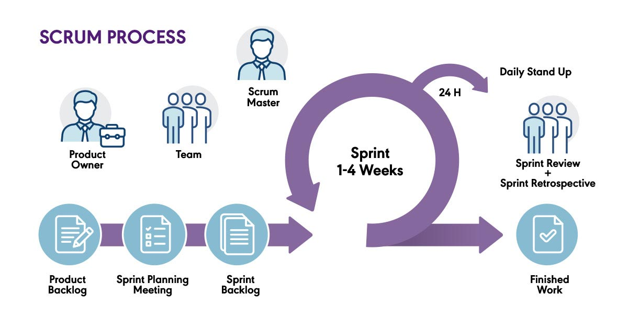

Slide 7
Scrum Roles
There are three major Scrum Roles:-
Product Owner
The product owner represents the customers and end users. Product owner collaborates with the development team to make sure that product backlogs are treated properly.
2. Scrum Master
The Scrum master acts like a guide to the scrum team. Scrum master ensures the scrum framework is properly followed and implemented.

Slide 8
Development Team
Development team has responsible persons who have the responsibility to deliver the product . These persons are self organizing and cross functional which makes them suitable for the work. They are accountable to deliver a product increment after each sprint.

Slide 9
Scrum Artifact
Scrum Artifacts can be termed as the information that provide the support in the collaboration and decision making process in scrum.
There are three major scrum artifacts :-
1. Product Backlog
It is the prioritized list of features in a product. It shows the requirements of the products and is managed by Product Owner.

Slide 10
2. Sprint Backlog
It is subset of the product backlogs. It can be termed as the work requirements to be completed during a specific sprint.
3. Increment
It represents the outcome that the developer team got after a sprint. This can be termed as the number of the product backlogs at the end of sprint.

Slide 11
Scrum events
What is Sprint?
How to conduct the Sprint.
How to determine the length/duration of the Sprint.

Slide 12
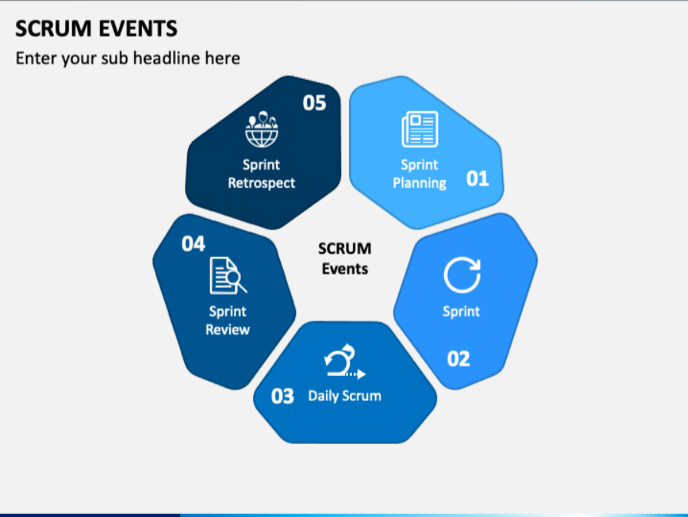

Slide 13
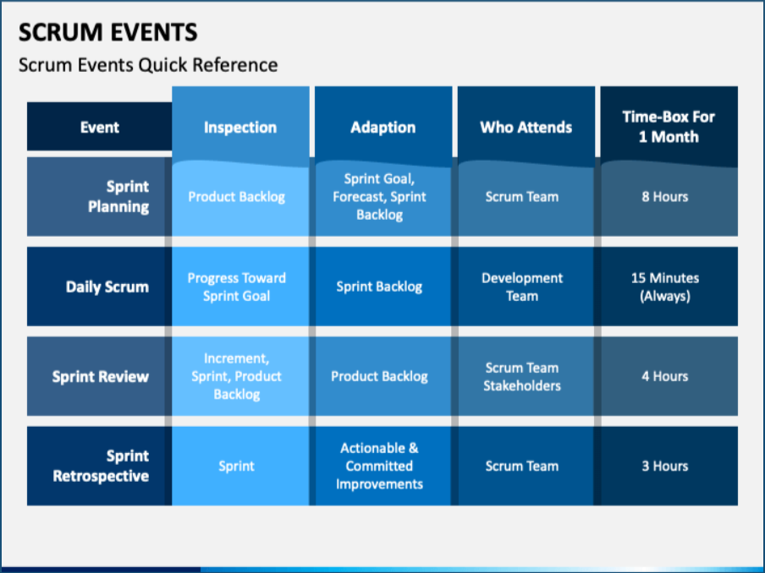

Slide 14
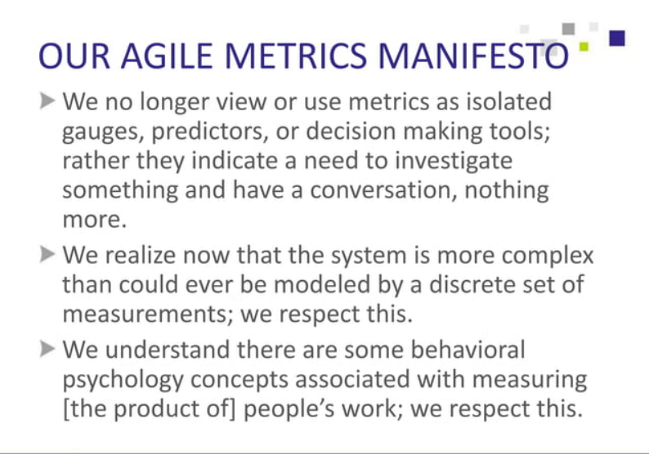
Scrum Metrics

Slide 15
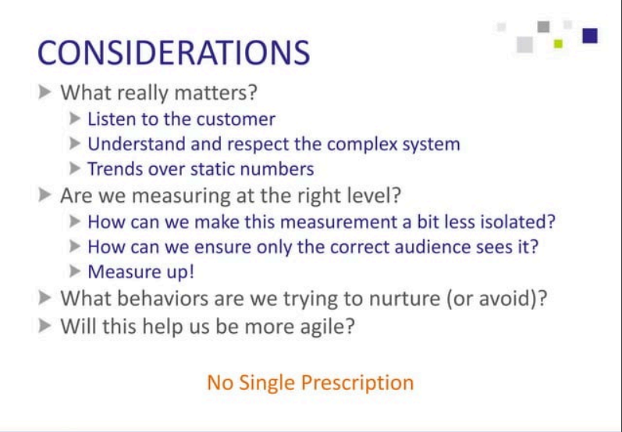
Suggested Scrum Metrics

Slide 16

Working Software

Slide 17
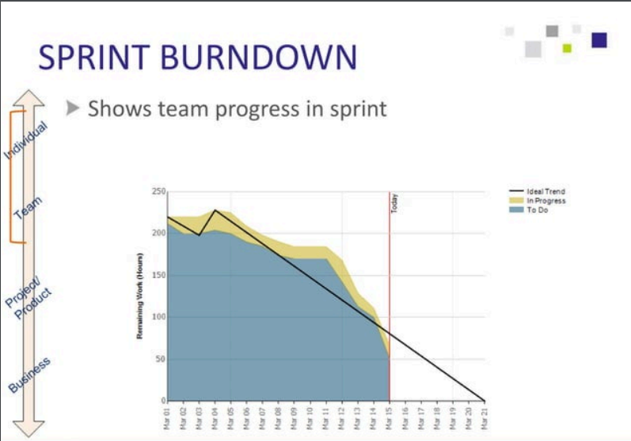
Sprint BurnDown

Slide 18
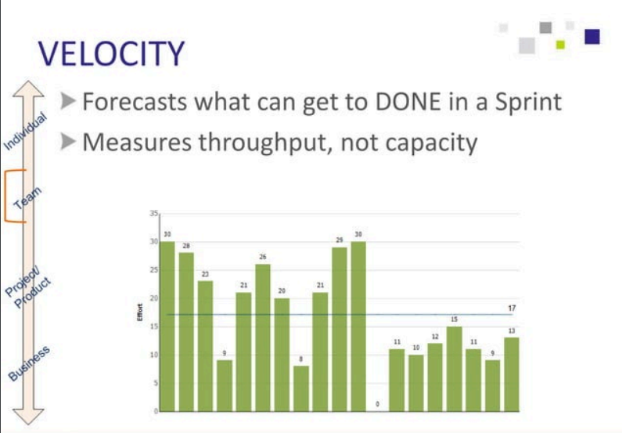
Sprint Velocity

Slide 19
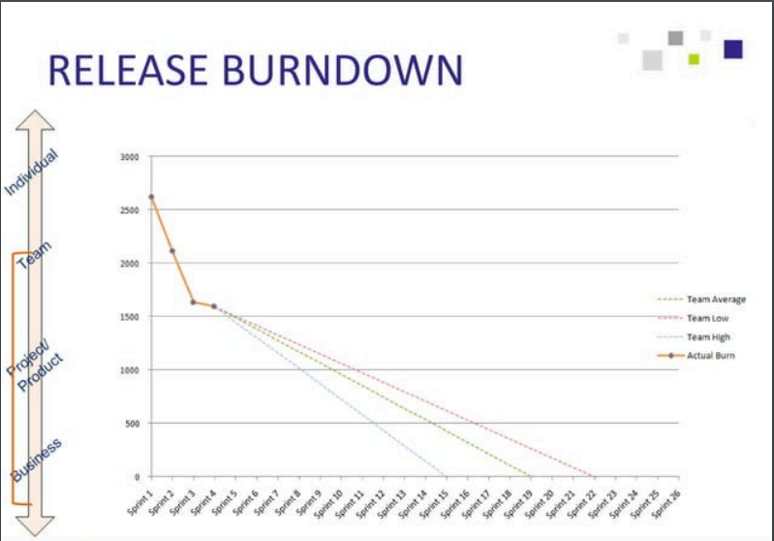
Release Burndown

Slide 20
Thankyou

